Slide 2
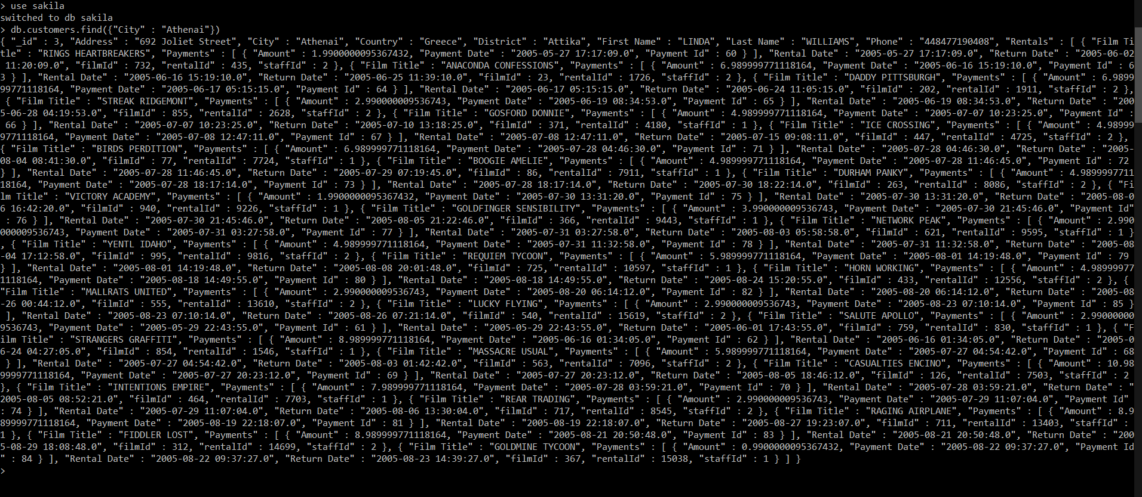
db.customers.find({"City" : "Athenai"})

Slide 3
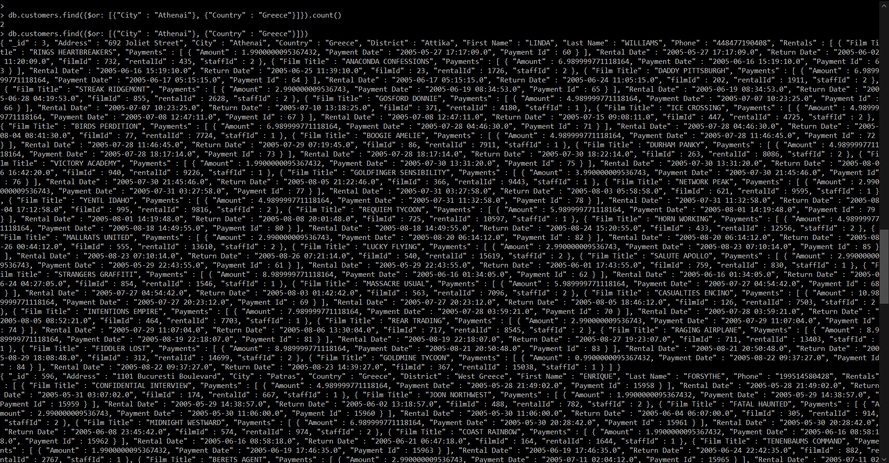
db.customers.find({$or: [{"City" : "Athenai"}, {"Country" : "Greece"}]})
db.customers.find({$or: [{"City" : "Athenai"}, {"Country" : "Greece"}]}).count()

Slide 4
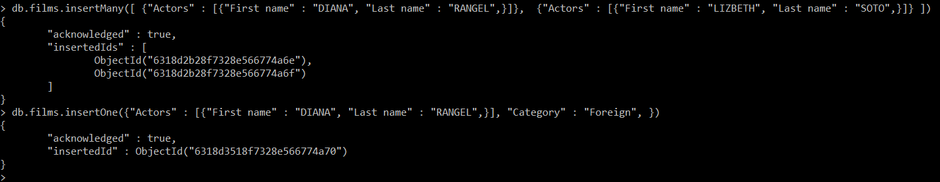
db.films.insertMany([ {"Actors" : [{"First name" : "DIANA", "Last name" : "RANGEL",}]}, {"Actors" : [{"First name" : "LIZBETH", "Last name" : "SOTO",}]} ])
db.films.insertOne({"Actors" : [{"First name" : "DIANA", "Last name" : "RANGEL",}], "Category" : "Foreign", })
db.films.updateMany( {Length: { $ne: 126 } }, { $set: { Length: 126 } })

Slide 5
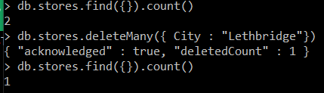
db.stores.find({}).count()
db.stores.deleteMany({ City : "Lethbridge"})

Slide 6
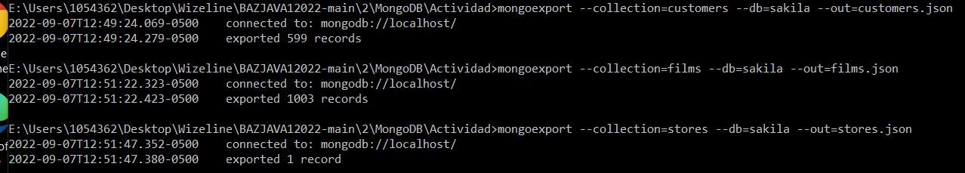
mongoexport --collection=customers --db=sakila --out=customers.json
mongoexport --collection=films --db=sakila --out=films.json
mongoexport --collection=stores --db=sakila --out=stores.json

